Slide 1

Title of your Project
ALOHA HOMES
Group members with StudentId
Shweta Bhutada 21104007
Manjiri Gole 21104006
Akshata Nalavade 21104003
Project Guide
Prof. Charul Singh

Slide 2
Contents
Introduction
Objectives
Scope
Features / Functionality
Project Outcomes
Technology Stack
Block Diagram/ Flow

Slide 3
1. Introduction
An online marketplace for artists who make home decor related crafts and support/help them to sell their products or goods on our platform.
Problem Faced By Handicrafts:
They have a hard time finding the right buyers to sell their crafts.
They lack in skills like marketing strategies, distribution and organization management and also managing finances.
They are not credited in proper way, if they sell them to retailers or wholesalers.
Solution:
We help artists especially from the rural areas who find it difficult to make their livelihood, although having exceptional talent.
We give them an open platform to share, collaborate and sell what they make with love for society.
We help in commercialization of their less known products.

Slide 4
2. Objectives
Main objectives of this platform are:
To build a marketplace for unique and creative goods.
To give customers a chance to support small artist and their business.
To increase innovation and introduce a healthy competition.
To educate customers about the craft they are buying.

Slide 5
3. Scope
Economic growth: this website is specially designed to promote small businesses and local business around the area helping Indian artists grow economically.
Easy accessibility and managing : Easy access to everyone and entrepreneurs who want to set up their business at anytime.
Analyzing and optimize your shop: gives you monthly and yearly reports on your business helping you analyze that on which parts are you lacking and on which products are the spiking the most interest from the user and help you boost your business.

Slide 6
4. Feature /Functionality
A quick login and registration page available for both buyers and sellers.
Simplified Category feature.
Give feedbacks/reviews for the product purchased.
Including a description and good quality images of the product.
Range of small business database
A database of handmade goods

Slide 7
5. Outcome of Project
User can log in and set up their shop.
User can search products to buy.
User will be able to sell their products.
Users can learn about products.

Slide 8
6. Technology Stack
Write what you have planned to develop front end ( GUI ) & Backend (Database if applicable)
- JAVA
-MySQL
-HTML /CSS

Slide 9
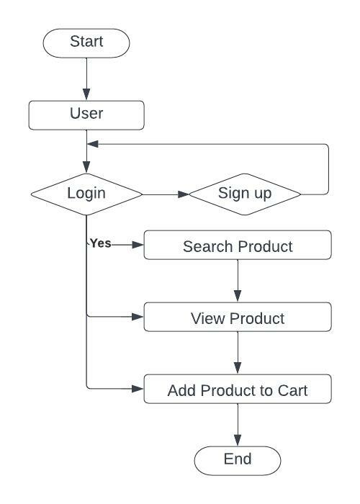
7. Block Diagram/ Flow Chart

Slide 10
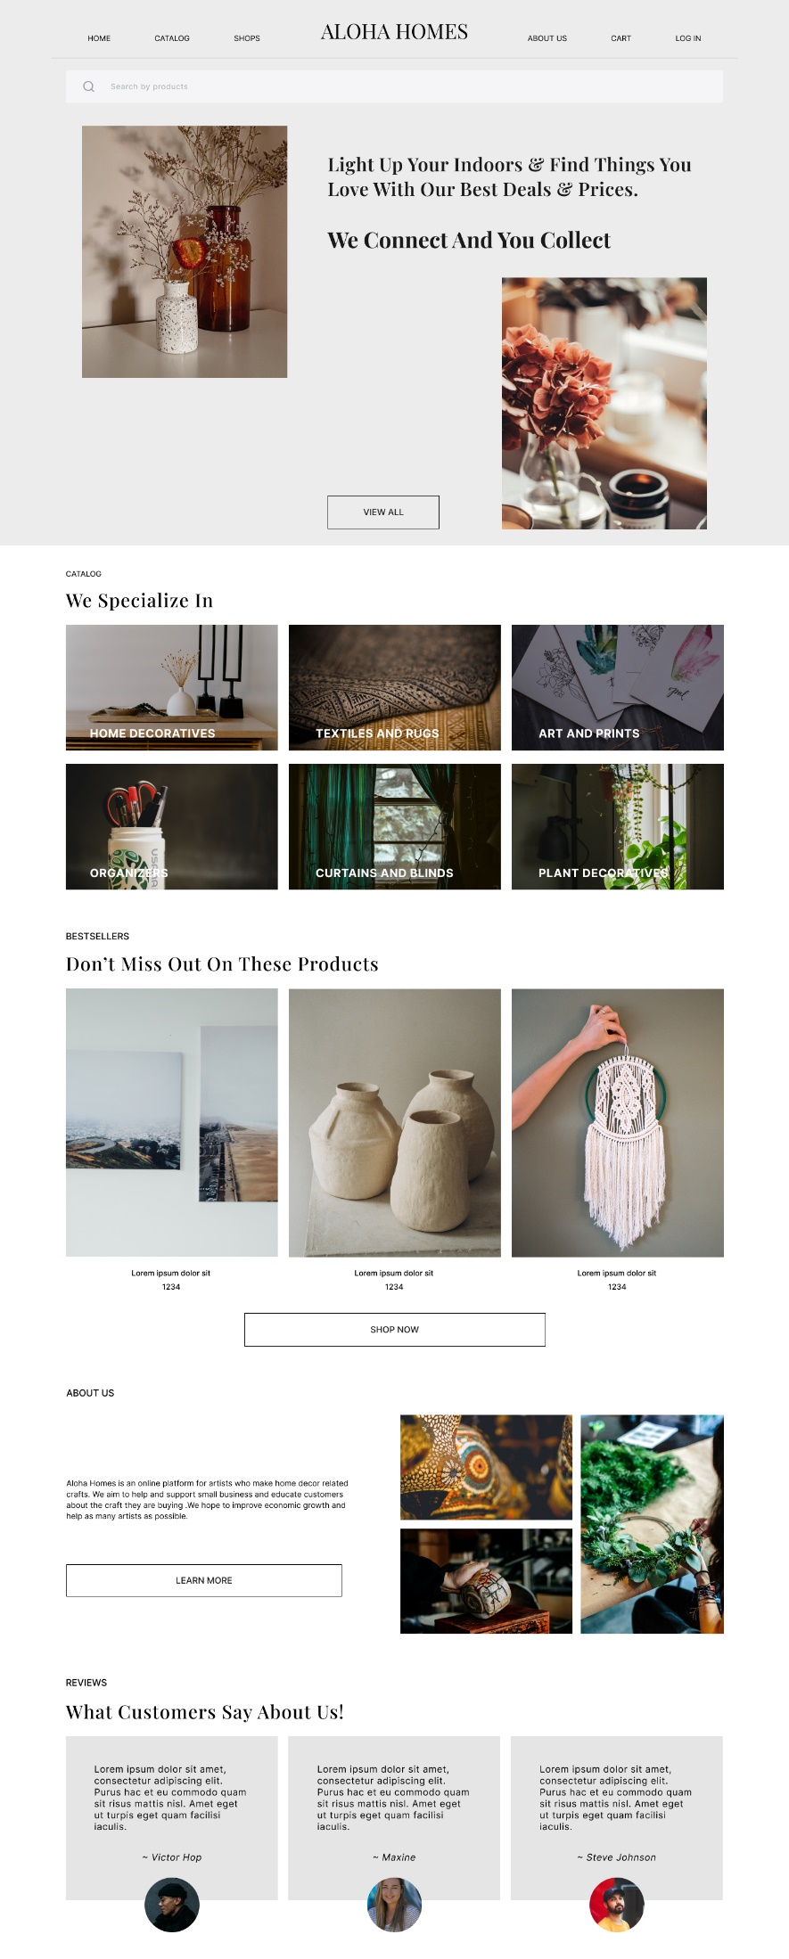
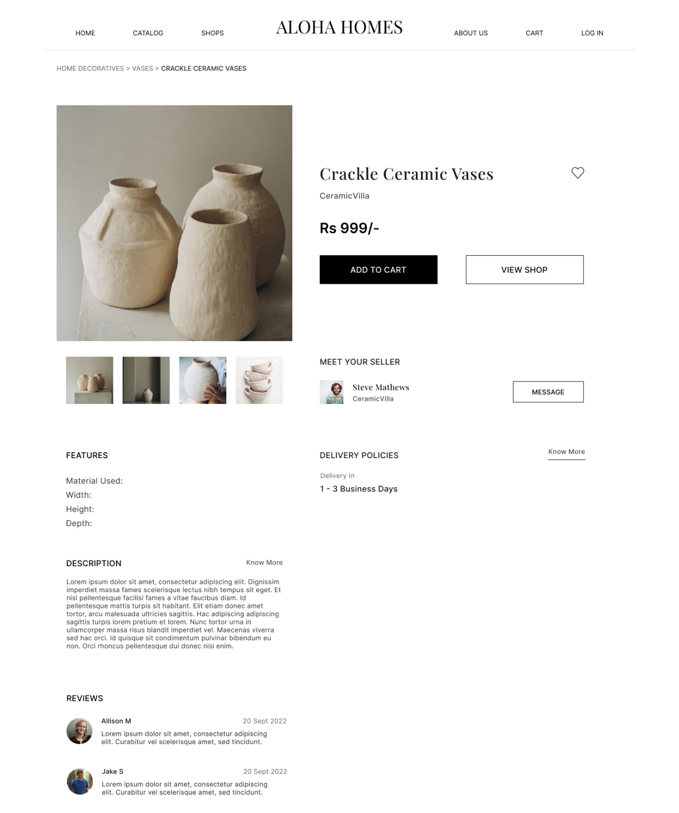
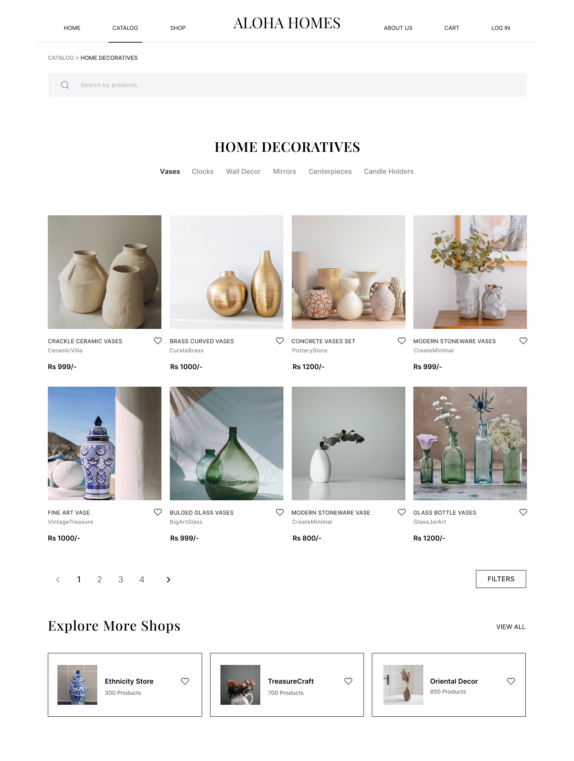

Slide 11
Thank You...!!

